Slide 1
U.S. Internal Migration Over Time
Teagan Zuniga
Notes:
Define internal migration – the movement of people from one region of a country to another

Slide 2
Research Questions
How has internal migration within the United States changed over time?
When people do migrate internally, where do they migrate from?
When people do migrate internally, where do they migrate to?
Notes:
Walk through the research questions

Slide 3
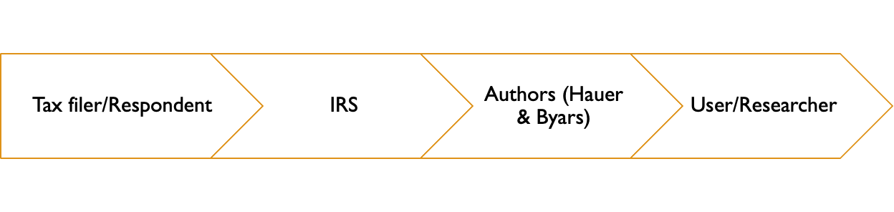
Data
•The IRS estimates uses tax filings
•If the tax filing address in year_{i} (origin) does not match the address in year_{i + 1} (destination), then a person is considered to have migrated
•Data is posted across 2000+ files!
•I pulled the data from Hauer & Byars (2019)
•Compiled the IRS migration data into a usable format

Slide 4
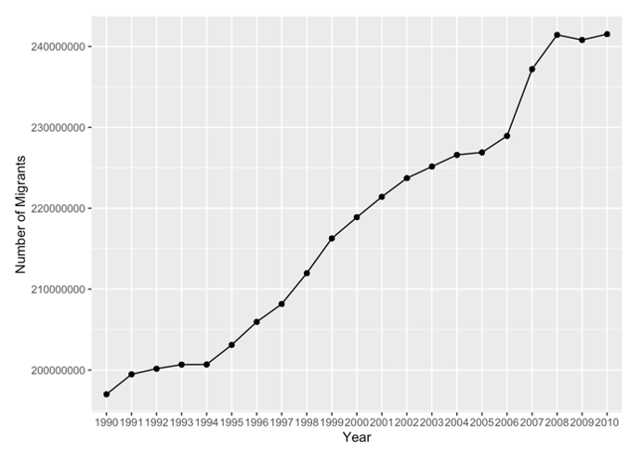
Migrants Over Time
Notes:
We see a steady increase over time – don’t need to discuss anything else

Slide 5
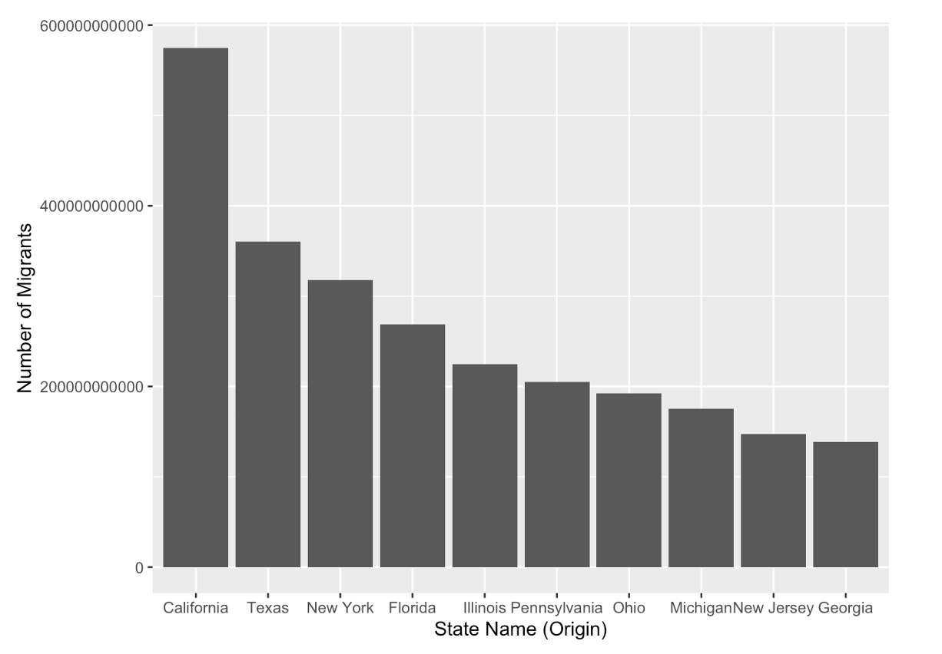
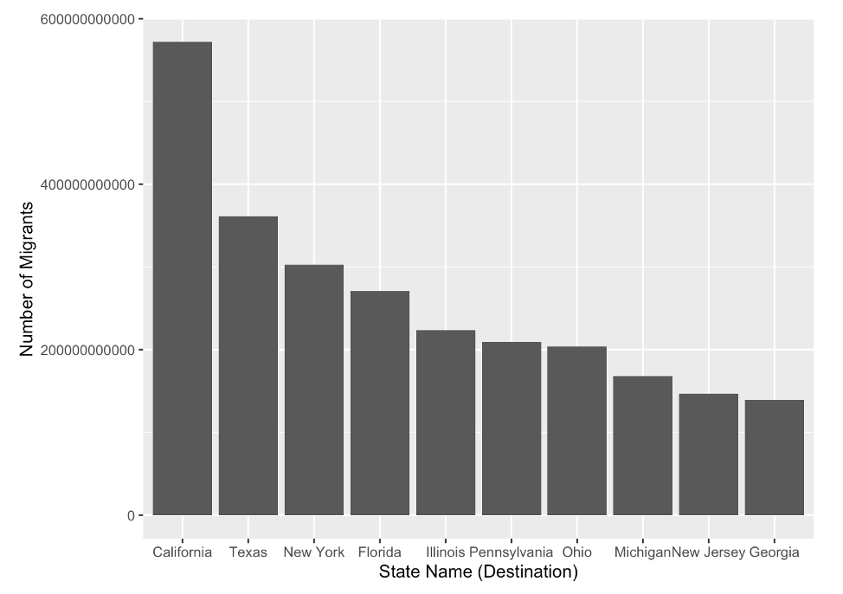
Origins & Destinations of Migrants
Notes:
Future steps – 1. look at state-to-state migration that accounts for state population; 2. causes of migration
Numbers are NOT exactly the same, but are very close, especially when you consider how big all of these numbers are

